Slide 1

Tire Shredding Design
Joseph Spear, Kenneth Shipley, Jordan Helman, Nicholas Keesler

Slide 2

Project Summary
Engineer a system to process scrap rubber produced during the tire making process at Hankook Tire Manufacturing.
System should adhere to Hankook safety guidelines and OSHA standards.
Rubber shreds should be an aggregate that can be reused by other companies and not sent to waste facilities,
Ultimately improving profits and reducing negative environmental effects.
This project is a collaboration with Hankook Tire Manufacturing.

Slide 3
Goal of the Project
It is desired that the Tire Shredder System will be able to produce a rubber aggregate that will be able to be sold to outside consumers who can use the recycled rubber.
A fully developed engineering plan should be ready to present by the end of the spring semester (May 2021). This will include:
3D model of the system.
Full mechanical analysis of the shredding process and rubber isolation.
System specifications sheet
Cost analysis of the project
Bill of Materials
Installation procedures.
Small scale proof of concept prototype

Slide 4
Potential Rubber Shred Buyers
Concrete companies
Portland Cement
Some companies do not require steel extraction from rubber.
Fuel source companies
Playground companies/government agency
Government Agencies for embankments and other purposes.

Slide 5
Rubber Research - Concrete Aggregate
One potential use for recycled tire rubber is incorporating it into cement mixtures to produce concrete.
Overall positive effects on the concrete:
Increased abrasion resistance as the volume of tire aggregate is increased
Increase in energy absorption in high performance concrete
Mostly for special circumstances in which a higher allowable deformation is desired.
Cleaned steel fibres can help resist fire spalling
Negative effects:
Significant decrease in compressive strength as more tire aggregate is added
Slightly more difficult to work with

Slide 6
Rubber Research - Embankments
Another possible use of scrap tires is embankment fill material.
Scrap tires combined with sand in this scenario.
Great use of large chunks (50mm to 250mm).
Rubber does not need the steel fibers and textile removed.
This could be a product of a secondary shred if not the first shred.
Overall low impact on the environment.
Emission concentration limits are not exceeded.
Most concerning scenario would be post-fire effects on the environment.
If for some reason the embankment catches fire, the burnt residue must be collected and disposed of as hazardous waste.
If not properly removed, it can have significant environmental penalties.

Slide 7
Rubber Research - Tire Derived Fuel
Most scrap tires are already used as fuel in:
Cement kilns
Pulp and Paper mills
Steel mills
Power plants
Typically used in supplement with other fuel sources.
Not all require the removal of steel belt.
Cement kilns need iron, so the belt can possibly stay inside the tire.
About the same energy generated as oil, and 25% more than coal.
Not completely environmentally friendly, but better than fossil fuels.
Slow the consumption of fossil fuels and remove tires from landfill.

Slide 8
Rubber Research - Others + Discussion
Asphalt
Athletic Surfaces
Playgrounds
Sound Control
Mulch for Gardens
Devulcanization for Carbon Black

Slide 9
System/Shredder research
Tire Shredding is a common way to reduce scrap tires into a recyclable state
Primary Shredder
Single-Shaft: Cuts uniform tire pieces anywhere from 2”- 6” depending on the screen used
Two-Shaft: Produces rough shreds anywhere from 4”- 6”
Secondary Shredder (Grater)
Refines the shreds from primary shredder into tire chips of about 1” or smaller
Removes steel from the shreds with a powerful magnet
Granulator
Takes rubber chips and removes the textile producing clean rubber mulch pieces
Output rubber mulch pieces are around ⅜”
Powderizer
Takes clean rubber mulch pieces and further shreds them into a fine rubber powder

Slide 10
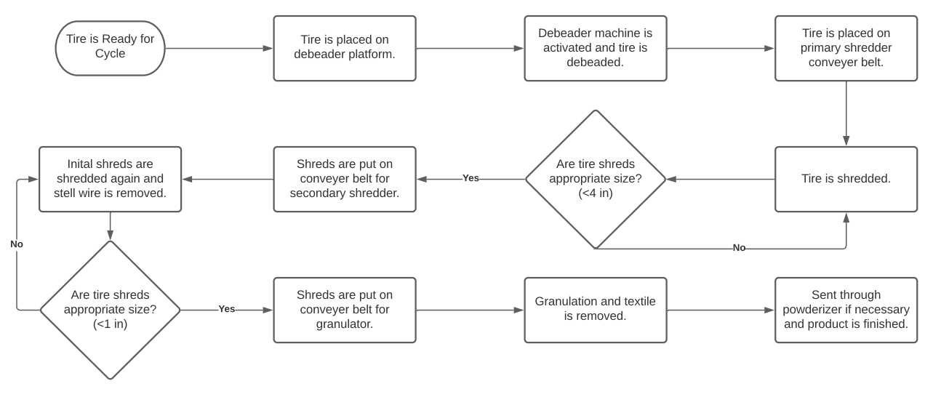
Shredding Process

Slide 11
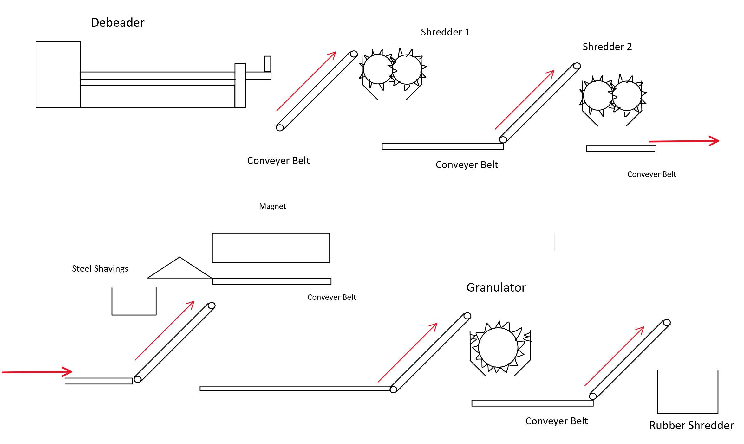
2D Schematic (Process)

Slide 12
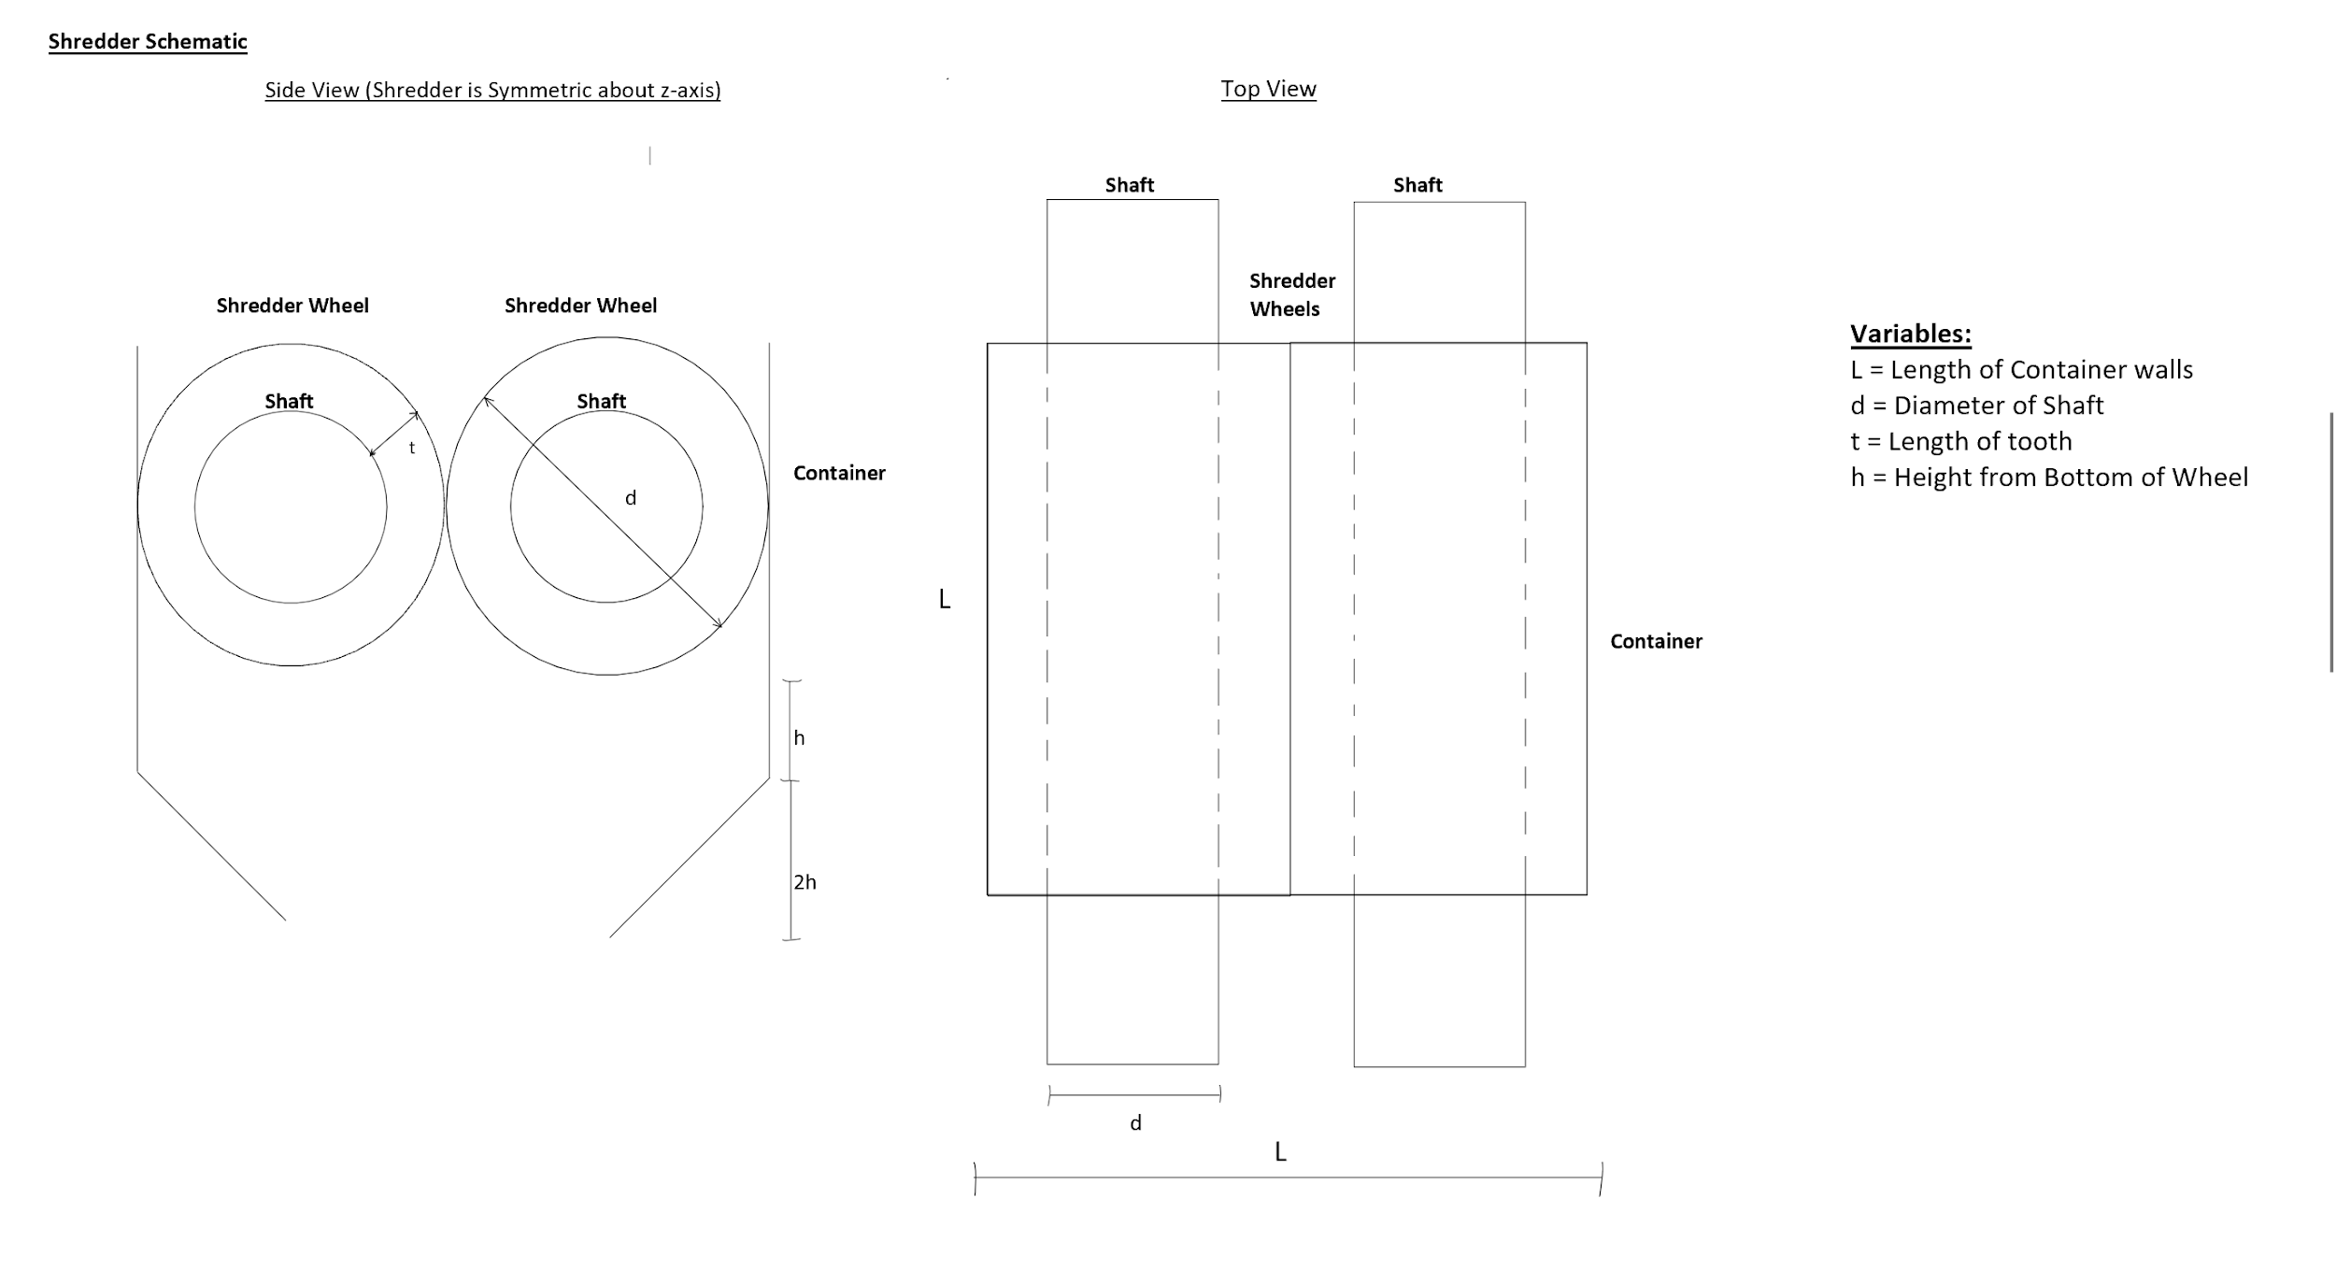
2D Schematic (Shredder)

Slide 13
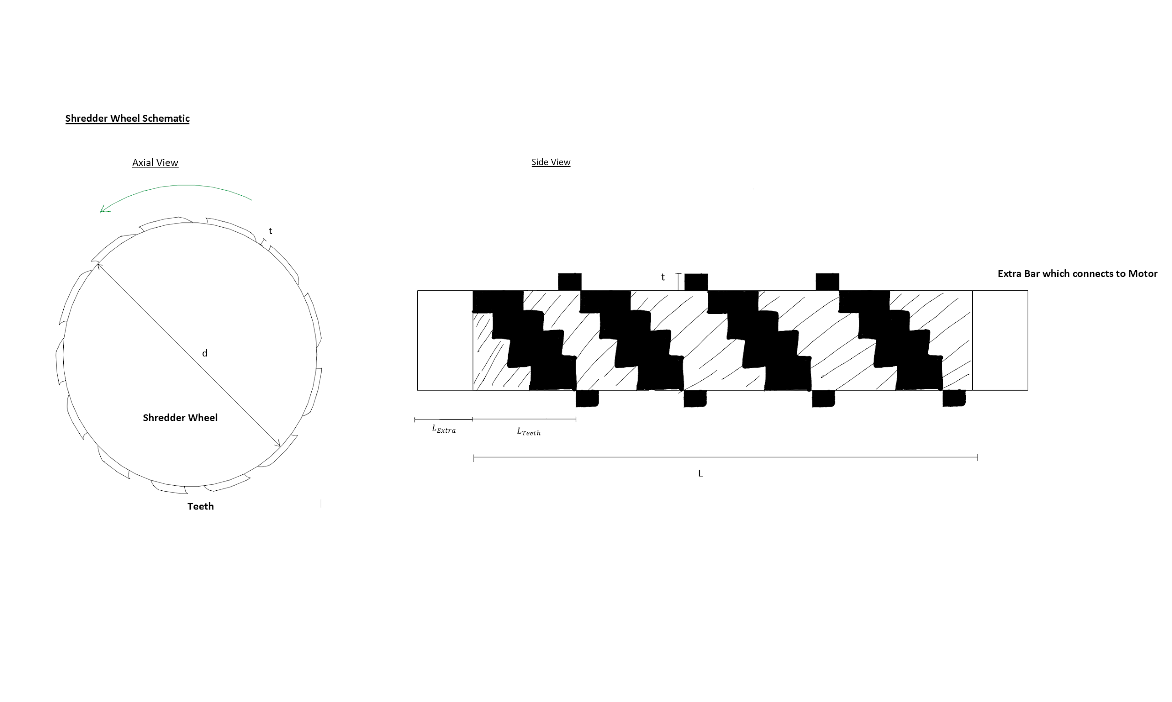
2D Schematic (Shredder Wheel)

Slide 14

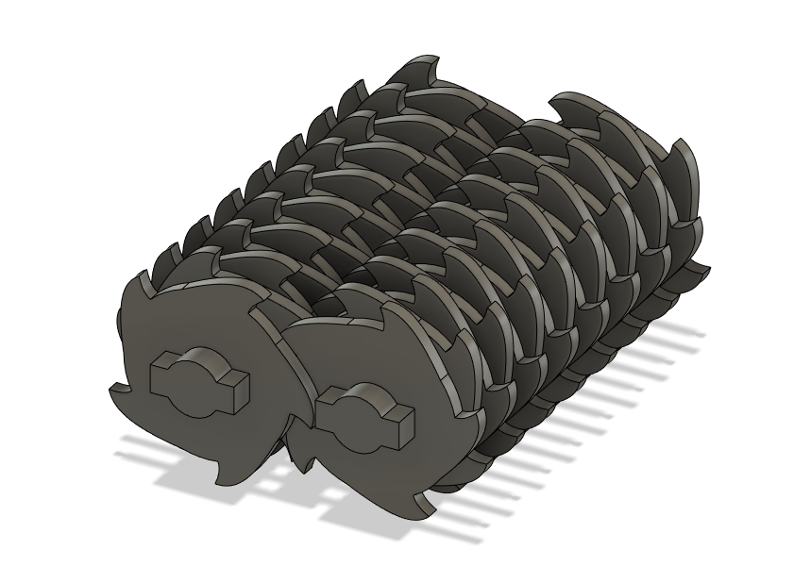
3D Schematic (Shredder Teeth)
We will develop a full 3D Schematic in CAD. Here is a preview.

Slide 15
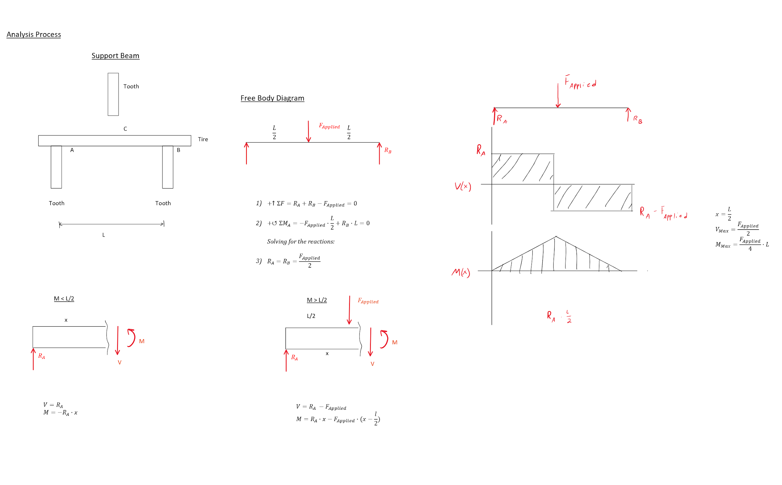
Analysis of a Simple Beam (FBD)
This FBD Analysis will be used as a starting point which we can expand upon to analyze the more complicated tire shredding system.

Slide 16
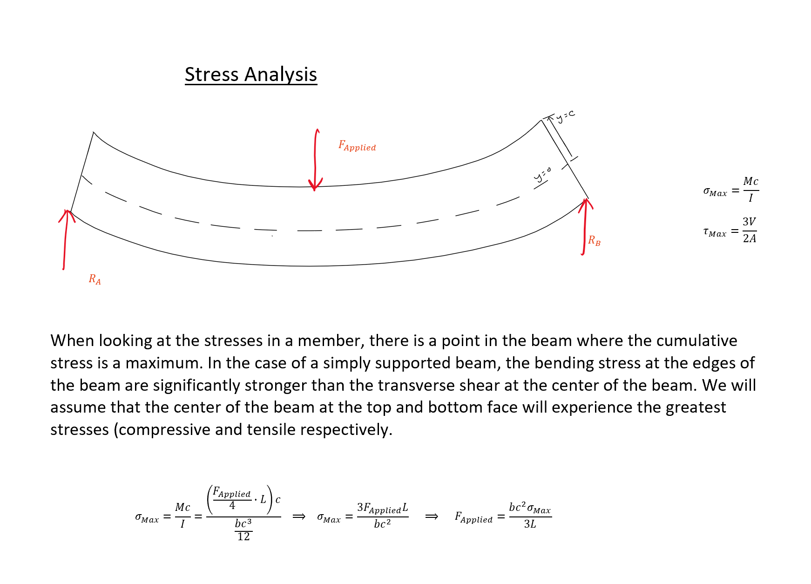
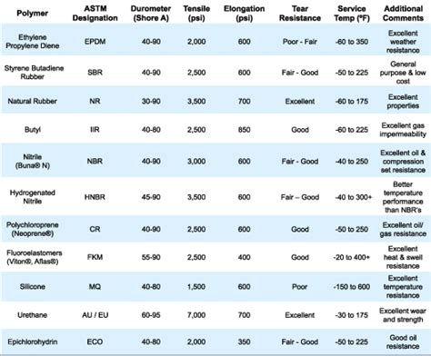
Analysis of a Simple Beam (Stress Analysis)
We will use known rubber strengths in the analysis to determine needed F that is applied. If material data sheets are given from Hankook, we will use that data.
1)
https://www.globalspec.com/learnmore/part_fabrication_production/molding_services/rubber_molding_services

Slide 17
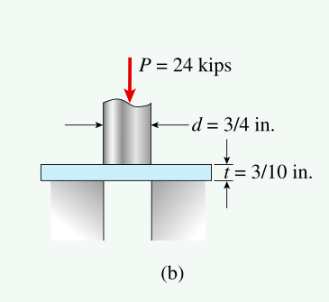
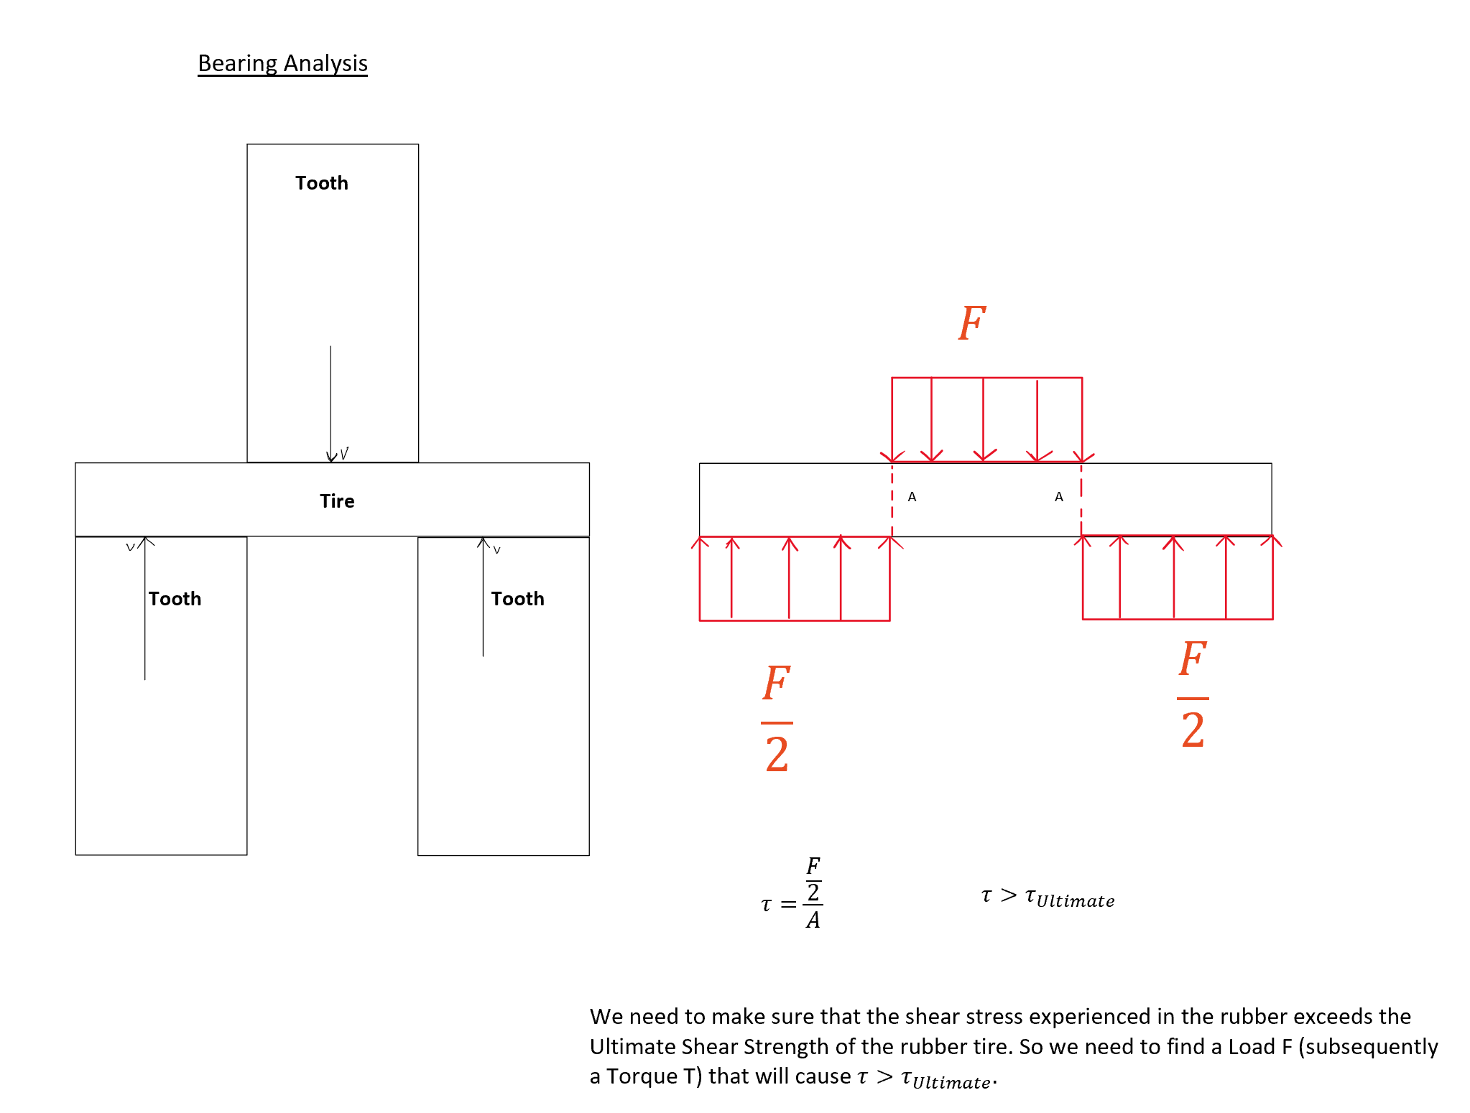
Analysis of Bearing Stress
Goodno Mechanics of Materials (p56)

Slide 18
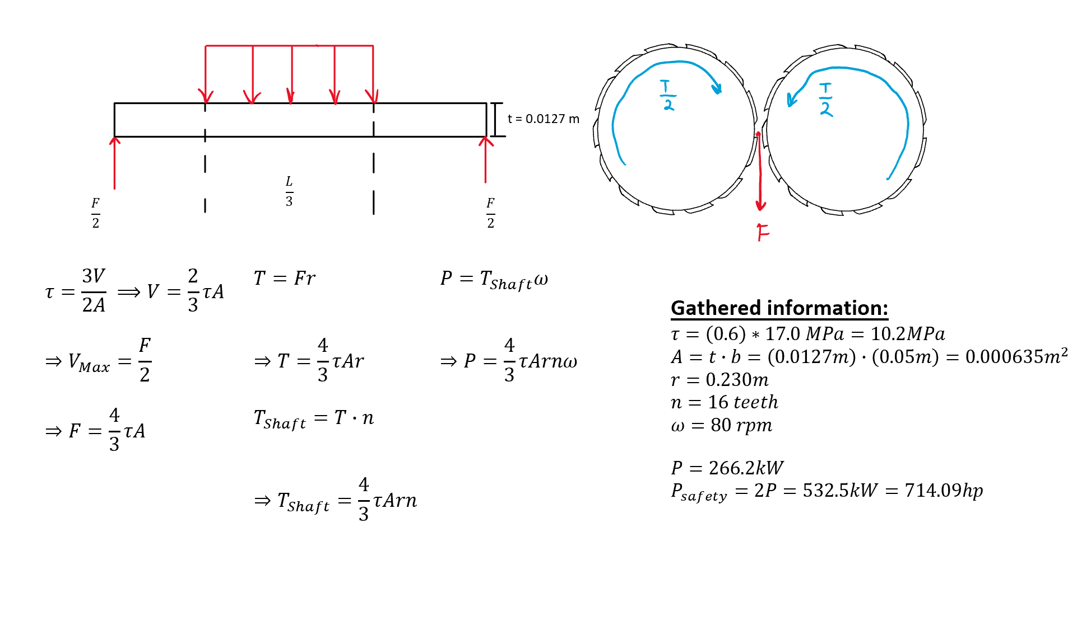
Power Analysis
Power needed to operate the Primary Shredder with the gathered data is calculated here.
P = Power
F = Applied force (from shafts)
T = Applied torque (from shafts)
𝜏 = Minimum required shear stress
t = Rubber chunk thickness
b = Rubber chunk depth
r = Radius of primary shredder shaft
𝜔 = Angular velocity of the shaft

Slide 19
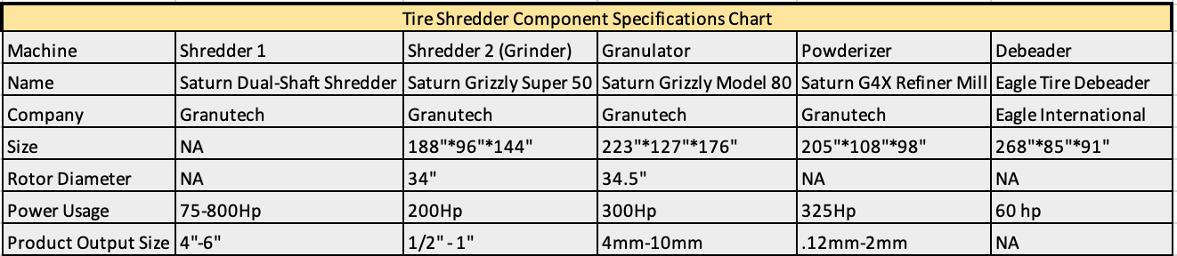
System Specifications

Slide 20
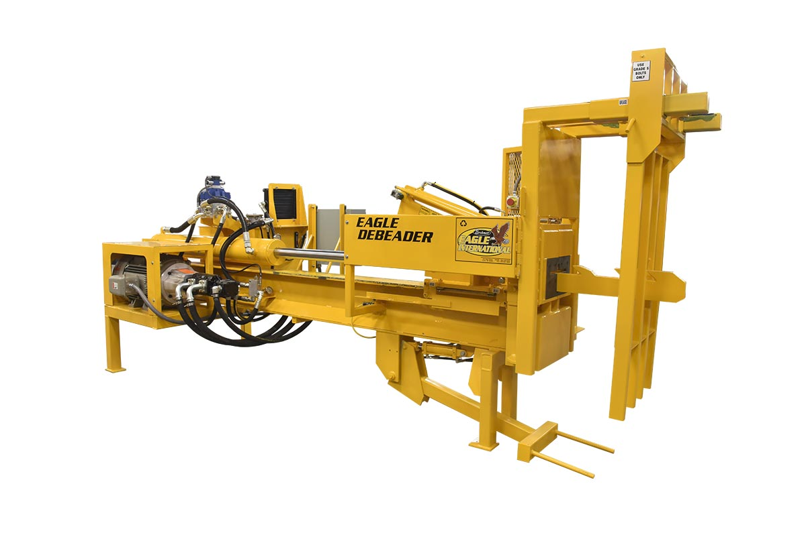
Debeader
Name: Eagle Tire Debeader
Company: Eagle International
Link:https://www.youtube.com/watch?v=BcnsO6shR3U&feature=emb_logo

Slide 21
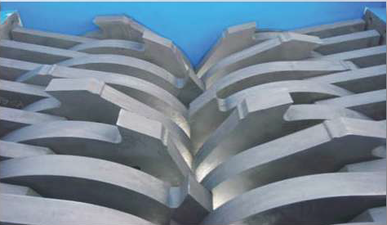
Primary Shredder
Name: Saturn Dual-Shaft Shredder
Company: Granutech
Link:https://www.youtube.com/watch?v=drfpeay6uCM&feature=emb_logo

Slide 22
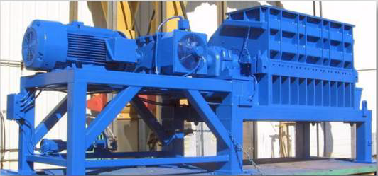
Secondary Shredder
Name: Saturn Grizzly Super 50
Company: Granutech
Link:https://www.youtube.com/watch?v=NheB_EiY-68&feature=emb_logo

Slide 23
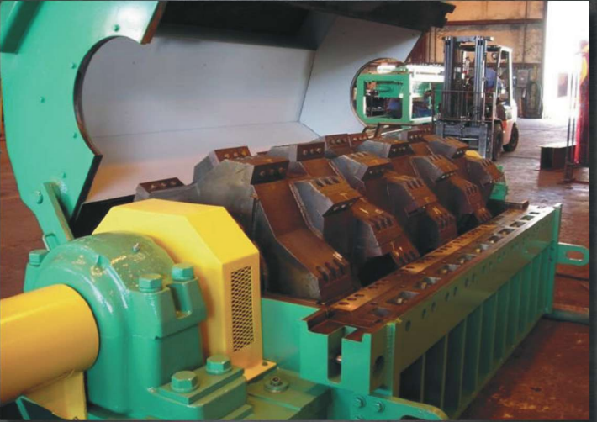
Granulator
Name: Saturn Grizzly Model 80
Company: Granutech
Link: https://www.youtube.com/watch?v=NheB_EiY-68&feature=emb_logo

Slide 24
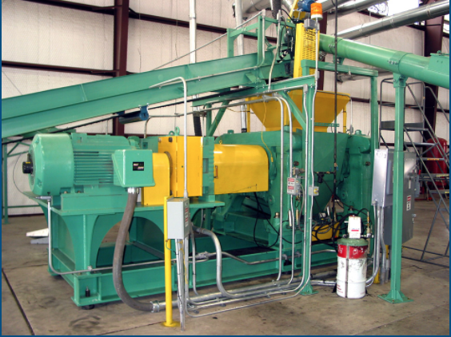
Powderizer
Name: Saturn G4X Refiner Mill
Company: Granutech
Link:https://www.youtube.com/watch?v=g4UbjlZOvbA&feature=emb_logo

Slide 25
Primary Options
Option 1 (Recommended)
System: Debeader -> Primary Shredder -> Secondary Shredder -> Granulator
Power Usage: 1360 hp
Power Cost: 109.4 USD/hr
System Cost: $1.3M - $1.8M
Option 2
System: Debeader -> Primary Shredder -> Secondary Shredder
Power Usage: 1060 hp
Power Cost: 85.29 USD/hr
System Cost: $1.1M - $1.7M
Option 3
System: Debeader -> Primary Shredder -> Secondary Shredder -> Granulator -> Powderizer.
Power Usage:1685 hp
Power Cost: 135.6 USD/hr
System Cost: $1.7M - $2.7M
Notes:
3D model

Slide 26
Other Options
Primary options are provided from Granutech and Eagle International , it is also possible to purchase these components from other companies including:
Eco-Green Equipment
Shredwells Recycling
CM Shredders
Airborne Disposal (Jeremy Bryan)
Multiple output system where setting up some conditions can produce a variable chip size.

Slide 27
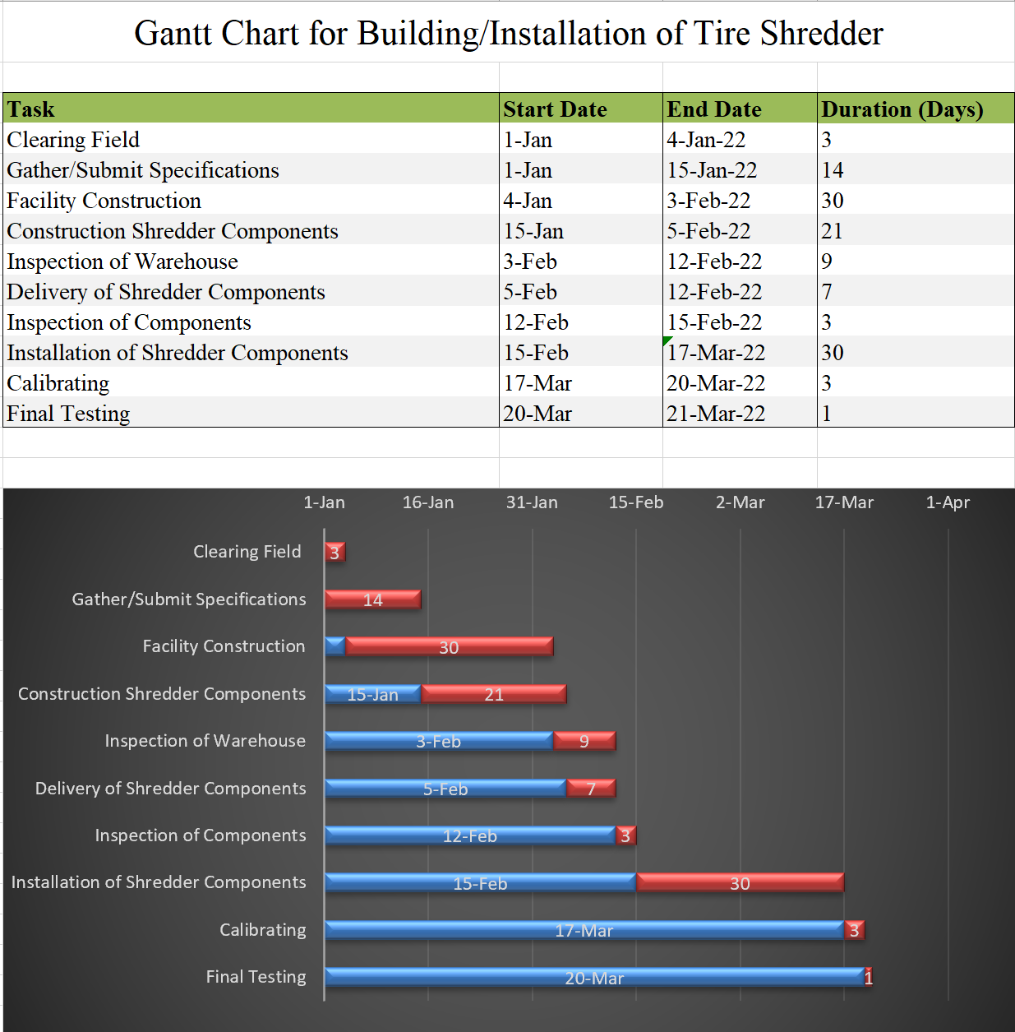
Theorized Installation Process
This Gantt Chart is an early draft of a potential production/installation schedule for the Tire Shredder. (Assuming start date is 1/1/2022)

Slide 28
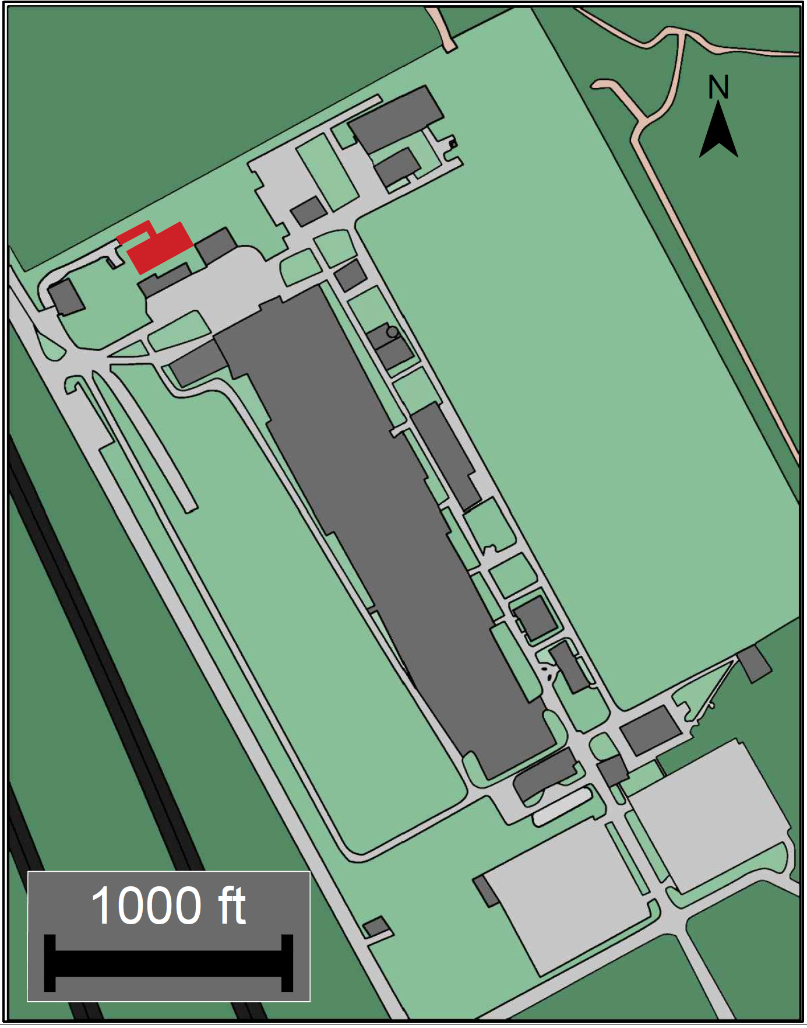
Hankook Site Map
In this site map, the most updated satellite view of the Hankook Tires facility was acquired from Microsoft Zoom Earth.
The Portion colored in Red represents the hypothetical tire shredder location, where the road would be extended to a building which houses the shredder.

Slide 29
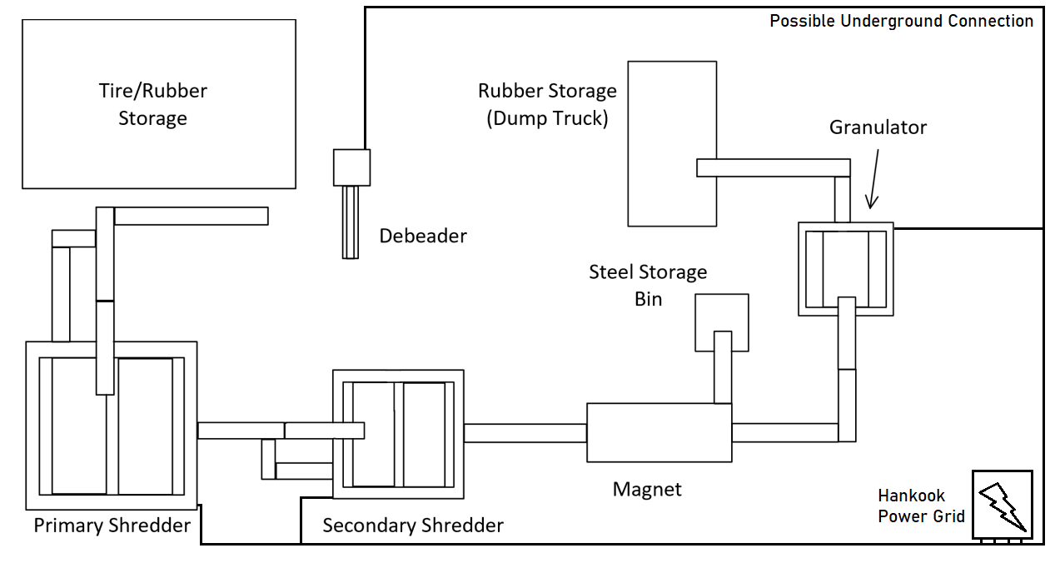
Theorized Overhead Layout

Slide 30
Pertinent Hankook and OSHA Safety Regulations
OSHA standard 29 CFR 1910.212, Machinery and Machine Guarding
One or more method of machine guarding
Attached if possible, available nearby if not
Special tools provided for moving material into and out of danger zone.
Revolving machinery shall be guarded by an enclosure
Machines should be securely anchored to prevent moving
Other pertinent OSHA standards include:
1910.219, Mechanical Power-Transmission Apparatus
1910.144, Safety Color Code for Marking Physical Hazards
1910.145, Specifications for Accident Prevention Signs and Tags
https://www.osha.gov/laws-regs/standardinterpretations/1985-07-12

Slide 31
Overall System Specifications
Based on option 1:
Total Power Usage: 1360 hp
Total Size: 10800 ft²
Theorized Output: 3 TPH
Estimated Cost: $1.3 - $1.8 million

Slide 32
Where do we go from here?
This system design is our current recommendation to achieve the project goal. Any input from the Hankook Tire team would be greatly appreciated. Currently, we plan to:
Get in contact with companies regarding potential rubber scrap sales.
Develop a physical model of the system.
Produce an accurate Bill of Materials and Gantt Chart.
More detailed inspection of sizes and warehouse dimensions.
Any Questions?

Slide 33
References
Valadares, F., Bravo, M., & de Brito, J. (2012). Concrete with Used Tire Rubber Aggregates: Mechanical Performance. ACI Materials Journal, 109(3), 283–292. https://doi-org.ezproxy.lib.apsu.edu/10.14359/51683818
Silva, F. M., Miranda Jr., E. J. P., Dos Santos, J. M. C., Gachet-Barbosa, L. A., Gomes, A. E., & Lintz, R. C. C. (2019). The use of tire rubber in the production of high-performance concrete. Ceramica, 65(SUPL.1), 110–114. https://doi-org.ezproxy.lib.apsu.edu/10.1590/0366-6913201965S12598
Figueiredo, Fabio & Huang, Shan-Shan & Angelakopoulos, Harris & Pilakoutas, Kypros & Burgess, Ian. (2019). Effects of Recycled Steel and Polymer Fibres on Explosive Fire Spalling of Concrete. Fire Technology. 10.1007/s10694-019-00817-9.
“Chapter 1 Tension, Compression, and Shear.” Mechanics of Materials, by James Monroe Gere and Barry J. Goodno, Cengage Learning., 2018, pp. 1–77.
Hennebert, P., Lambert, S., Fouillen, F., & Charrasse, B. (2014). Assessing the environmental impact of shredded tires as embankment fill material. Canadian Geotechnical Journal, 51(5), 469–478. https://doi-org.ezproxy.lib.apsu.edu/10.1139/cgj-2013-0194
Reisman, J. I. (1997, October). Air Emissions From Scrap Tire Combustion. Retrieved October 26, 2020, from https://www3.epa.gov/ttncatc1/dir1/tire_eng.pdf
E. (2016, February 22). Tire-Derived Fuel | Scrap Tires. Retrieved October 27, 2020, from https://archive.epa.gov/epawaste/conserve/materials/tires/web/html/tdf.html
http://www.matweb.com/search/datasheet.aspx?matguid=40aae1f68c9e45158e7bc642568b5ea9&ckck=1

